Slide 1
Cyberinfrastructure Day @ California State University Dominguez Hills Friday June 24 2011
Cluster Computing
Henry Neeman, Director
OU Supercomputing Center for Education & Research (OSCER)
University of Oklahoma

Slide 2
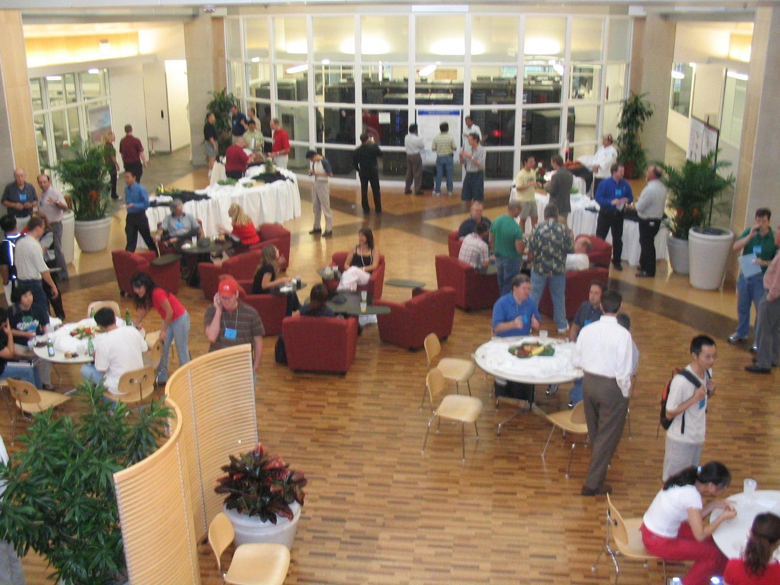
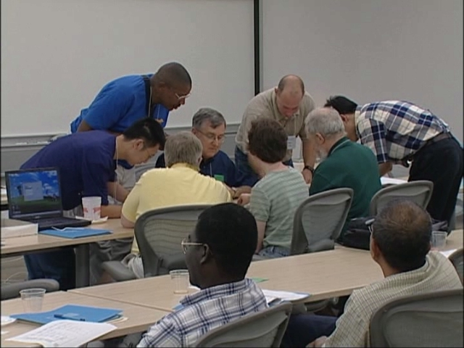
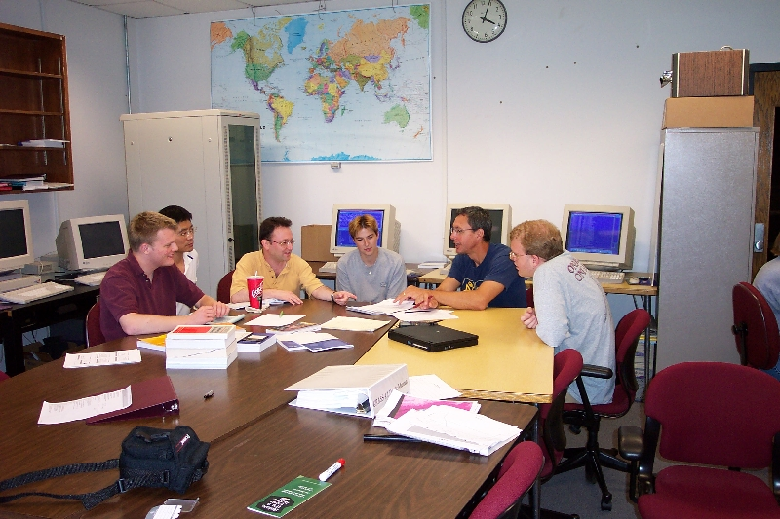
PEOPLE
2

Slide 3
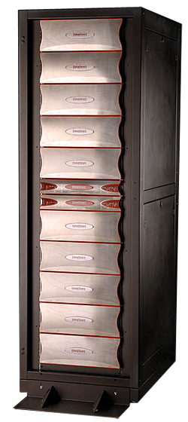
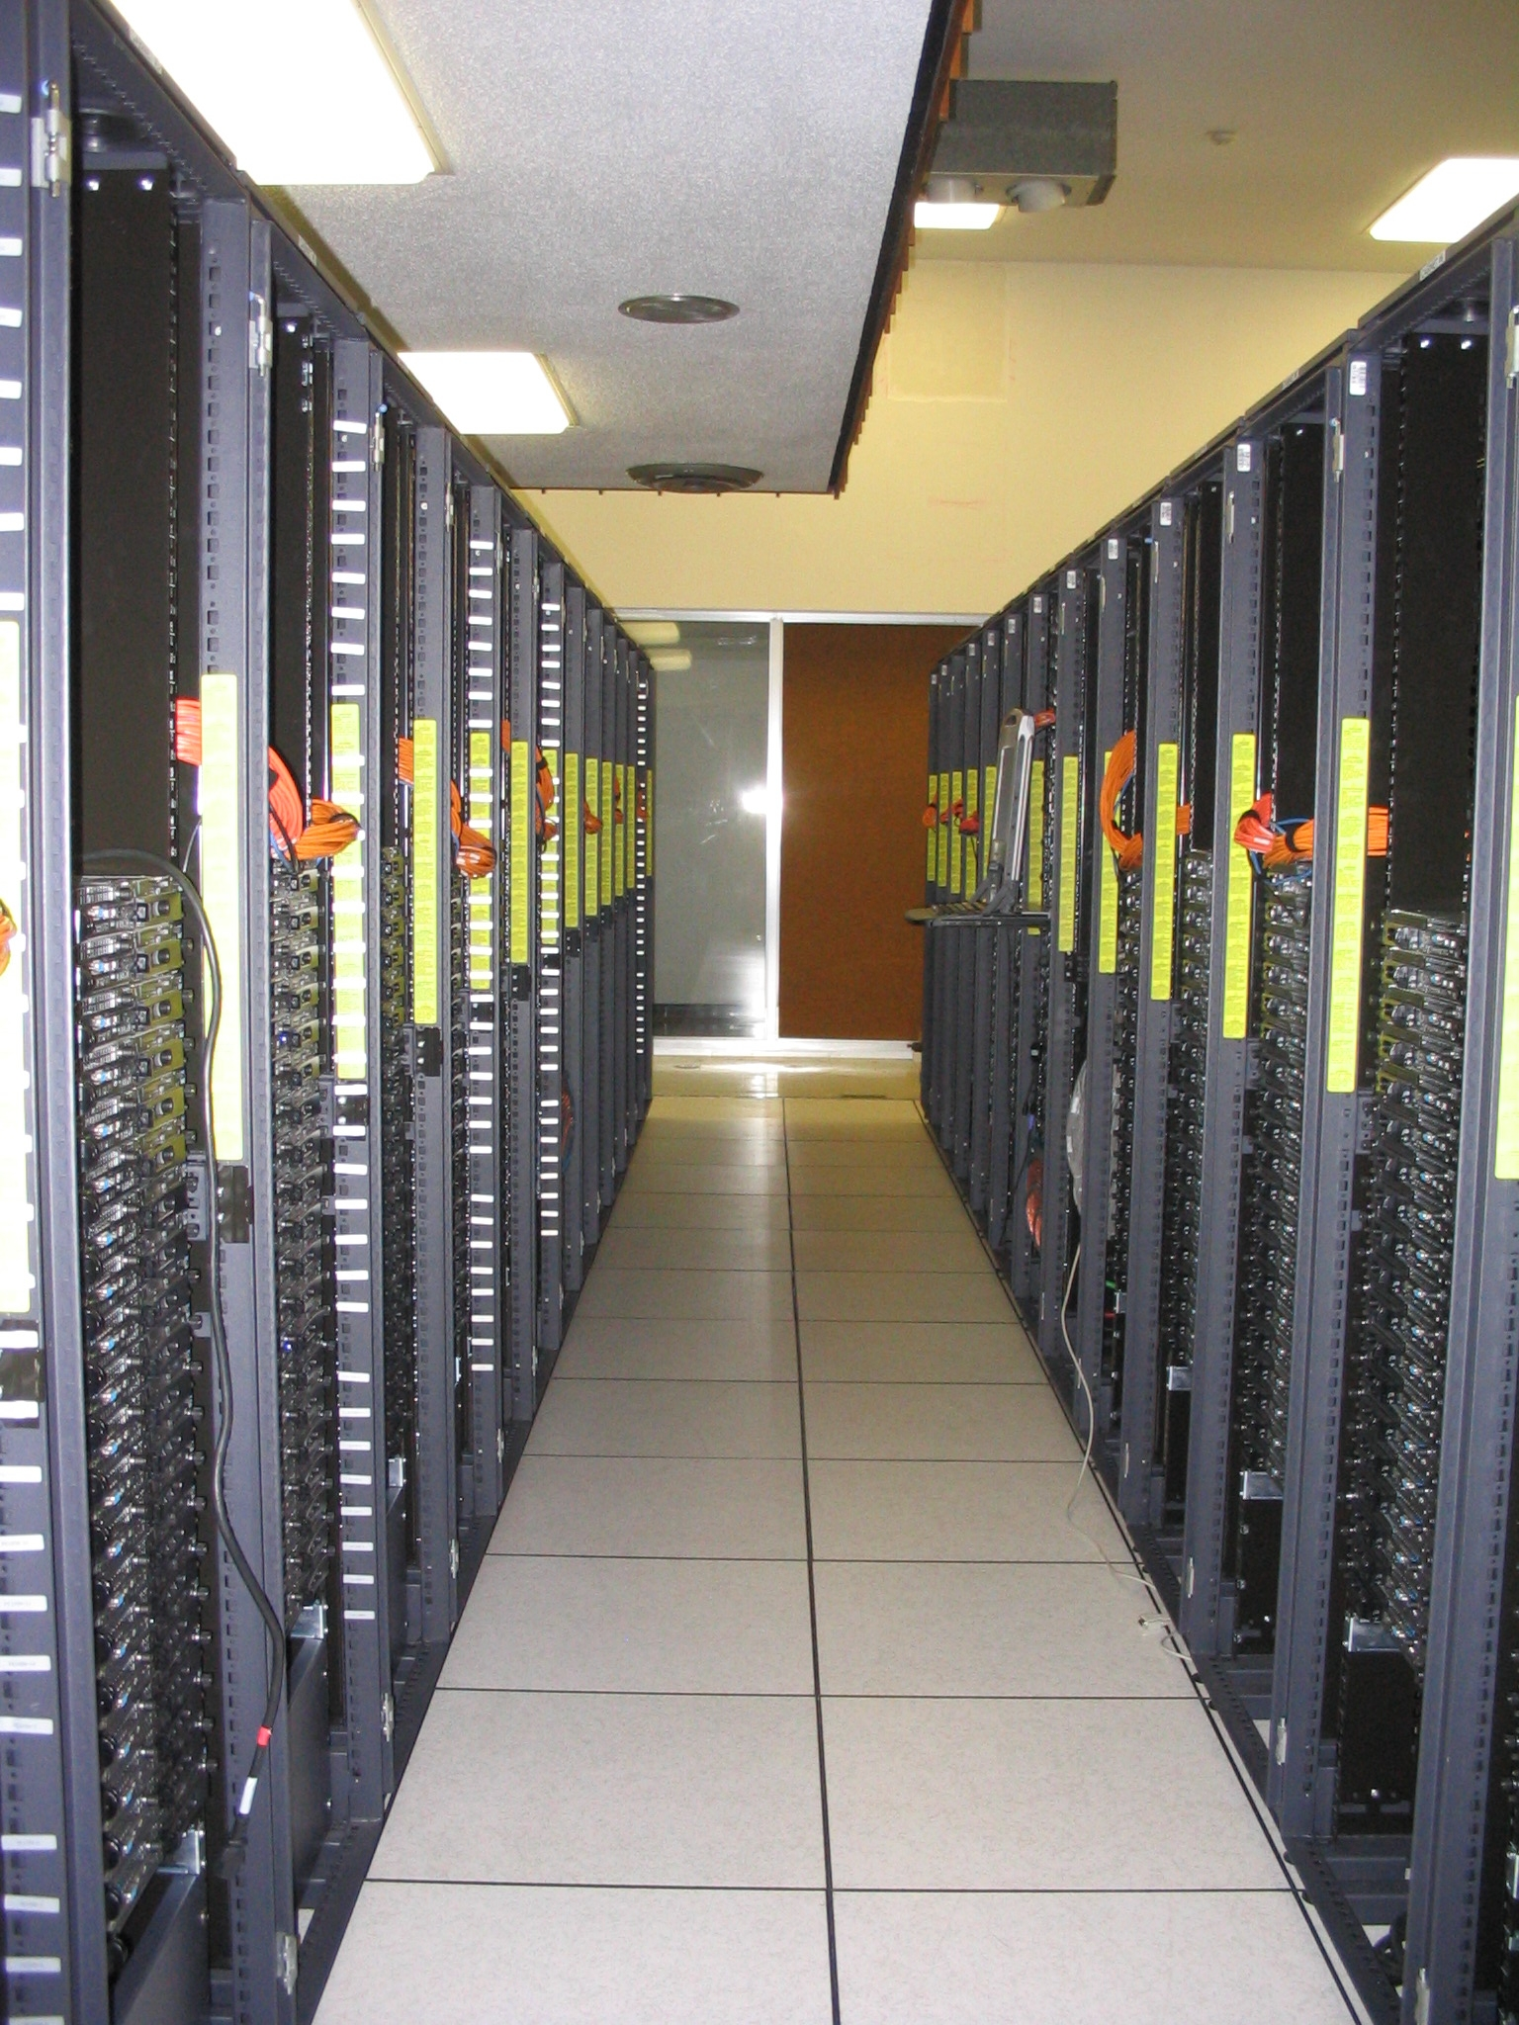
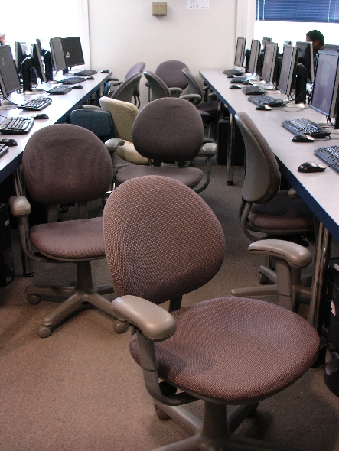
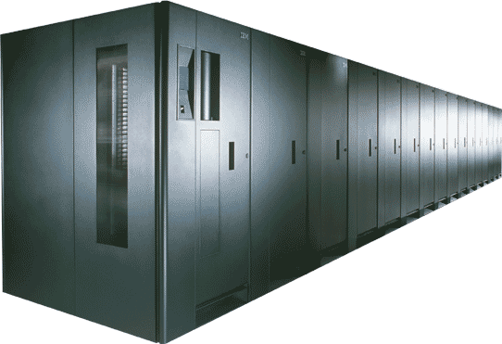
THINGS

Slide 4
Thanks for your attention!
Questions?
www.oscer.ou.edu
hneeman@ou.edu

Slide 5
What is a Cluster?
“… [W]hat a ship is … It's not just a keel and hull and a deck and sails. That's what a ship needs. But what a ship is ... is freedom.”
– Captain Jack Sparrow
“Pirates of the Caribbean”

Slide 6
What a Cluster is ….
A cluster needs of a collection of small computers, called nodes, hooked together by an interconnection network (or interconnect for short).
It also needs software that allows the nodes to communicate over the interconnect.
But what a cluster is … is all of these components working together as if they’re one big computer ... a super computer.

Slide 7
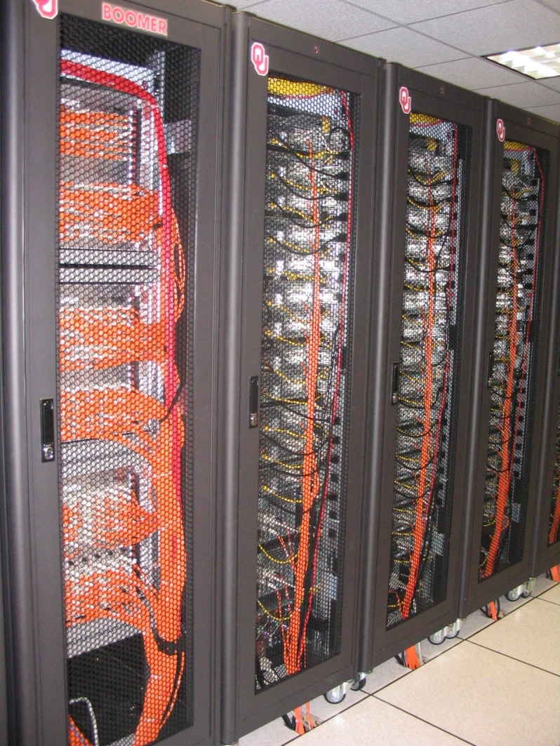
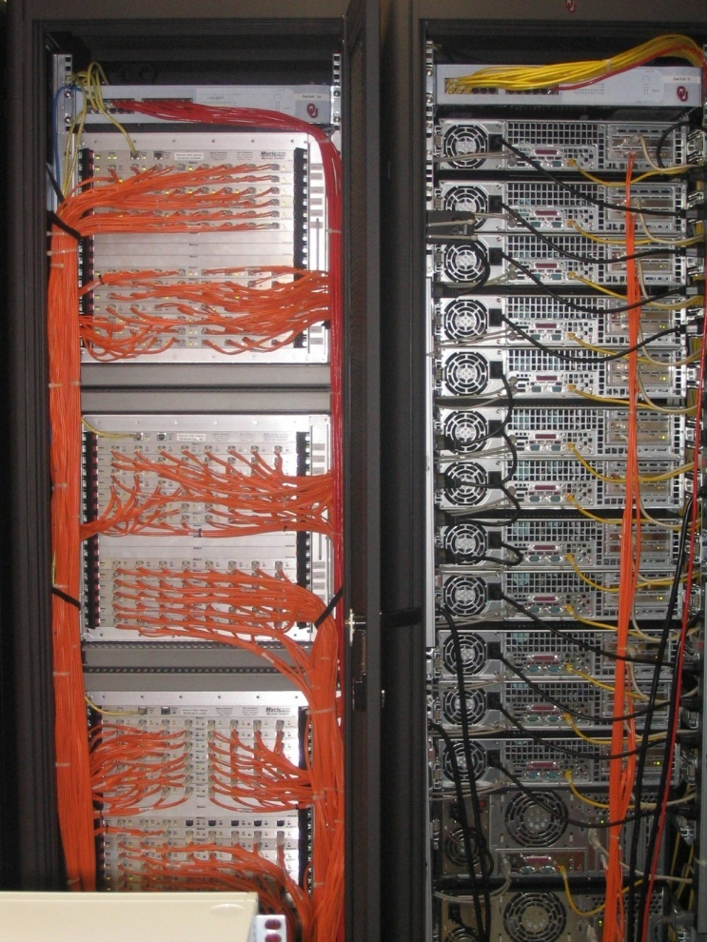
An Actual Cluster
Interconnect
Nodes

Slide 8
OU’s Dell Intel Xeon Linux Cluster
1,076 Intel Xeon CPU chips/4304 cores
528 dual socket/quad core Harpertown 2.0 GHz, 16 GB each
3 dual socket/quad core Harpertown 2.66 GHz, 16 GB each
3 dual socket/quad core Clovertown 2.33 GHz, 16 GB each
2 x quad socket/quad core Tigerton, 2.4 GHz, 128 GB each
8,800 GB RAM
~130 TB globally accessible disk
QLogic Infiniband
Force10 Networks Gigabit Ethernet
Red Hat Enterprise Linux 5
Peak speed: 34.5 TFLOPs*
*TFLOPs: trillion calculations per second
sooner.oscer.ou.edu

Slide 9
OU’s Dell Intel Xeon Linux Cluster
DEBUTED NOVEMBER 2008 AT:
#90 worldwide
#47 in the US
#14 among US academic
#10 among US academic excluding TeraGrid/XSEDE
#2 in the Big 12
#1 in the Big 12 excluding TeraGrid/XSEDE
sooner.oscer.ou.edu

Slide 10
OU’s Dell Intel Xeon Linux Cluster
Purchased mid-July 2008
First friendly user Aug 15 2008
Full production Oct 3 2008
Christmas Day 2008: >~75% of nodes and ~66% of cores were in use.
sooner.oscer.ou.edu

Slide 11
Moore’s Law
In 1965, Gordon Moore was an engineer at Fairchild Semiconductor.
He noticed that the number of transistors that could be squeezed onto a chip was doubling about every 18 months.
It turns out that computer speed is roughly proportional to the number of transistors per unit area.
Moore wrote a paper about this concept, which became known as “Moore’s Law.”

Slide 12
Moore’s Law Observed
GFLOPs:
billions of calculations per second
12

Slide 13
Moore’s Law: 2008 vs 2011 (CPU)
Sooner compute nodes:
64 GFLOPs per server
Fastest dual socket server today:
240 GFLOPs per server (3.75x)
So:
16 Sooner racks from 2008 =
4.5 racks in 2011
MEANING
Institutional cluster from 2008 =
Departmental cluster in 2011
sooner.oscer.ou.edu

Slide 14
Moore’s Law: 2008 vs 2011 (GPU)
Sooner compute nodes:
64 GFLOPs per server
Fastest GPU card today:
665 GFLOPs per card (10.4x)
So:
27 Sooner racks from 2008 =
52 graphics cards from 2011
MEANING
1 Sooner rack from 2008 =
2 graphics cards from 2011
sooner.oscer.ou.edu

Slide 15
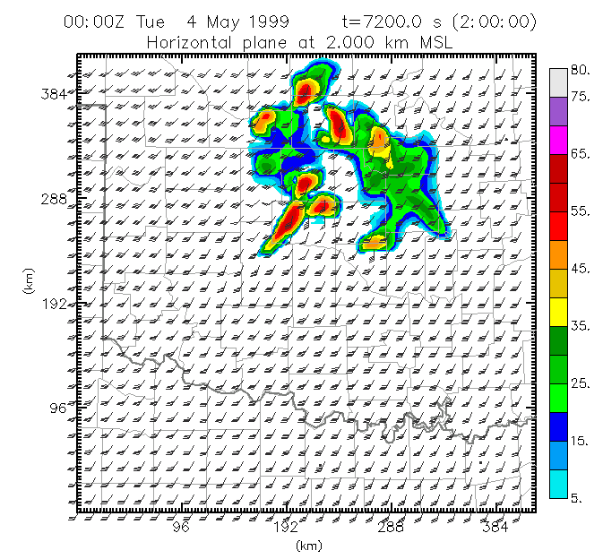
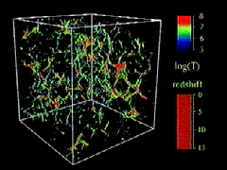
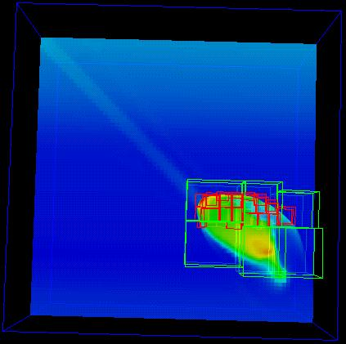
What are Clusters Used For?
Simulation of physical phenomena – things that are too big, too small, too slow, too fast, too expensive or too dangerous to study in real life
Weather forecasting
Protein folding
Energy management
Optimization: picking the best mix of stuff
Data mining: finding needles of information in a haystack of data
Gene sequencing
Detecting storms that might produce tornados
Visualization: turning a vast sea of data into pictures that a scientist can understand
Moore, OK
Tornadic
Storm
Courtesy Greg Bryan &
Mike Norman
Courtesy Kelvin Droegemeier
Courtesy Mordecai-Mark Mac Low

Slide 16
So You Want to Buy a Cluster ...

Slide 17
So You Want to Buy a Cluster ...
http://www.theonion.com/articles/the-scream-returns-from-twoyear-vacation-relaxed,9803/

Slide 18
NSF Major Research Instrumentation (MRI)
NSF has a program called Major Research Instrumentation (MRI).
This program will give your institution up to $4M for hardware, and they fund several clusters every year (but ask for less than $1M, to improve your chance of success).
Each institution only gets 2 MRI acquisition proposal slots per year, so you have to convince your institution that you should get one.
If you line up a couple dozen participants, you’ve got a very compelling argument why you should get one of the slots.

Slide 19
NSF MRI Budget
Ask for a little under $1M: at $1M and above, there’s an extra round of reviews that’s much harder to survive.
Spend your NSF budget on hardware, not on space, power, cooling (disallowed because MRI won’t pay for infrastructure).
Non-PhD-granting institutions are exempt from providing cost share.
Describe how your hardware will be administered. (And DON’T say that your sysadmin will be a grad student.)
Include a letter of commitment listing everything that will be provided by your institution.

Slide 20
NSF MRI Hardware
Justify your particular hardware decision, especially if it’s more expensive than a vanilla x86-64 cluster.
Avoid listing multiple different resources – that’ll look like a shopping list. Make it look like one big, coherent thing with multiple pieces working together.
Don’t include components that very few users will want to use – they should pay for those components on their own project budgets.
Include one or more vendor quotes for your hardware in the Supplementary Documents.

Slide 21
NSF MRI Projects to Use the Hardware
Describe several research projects, including well-funded “hero” projects, each in about a page of detail, to showcase your top users.
Also list several other research projects in less detail, to show that the hardware will be busy all the time.
You don’t need a unifying science or engineering theme: Computational Science & Engineering is fine.
List the number of faculty, staff and students who will use the hardware, for each of the projects and in total. Include a summary table.
If a research project involves multiple institutions, specify which parts will be done by your institution.
List all the relevant current and pending funding, for each research project and in total, in the project description.

Slide 22
Oklahoma Cyberinfrastructure Initiative

Slide 23
OK vs LA
Population
OK 3.75M, LA (city limits) 3.79M, LA (metro) 15M
Population Density (people per square mile)
OK 55, LA (city) 7545
Gross Domestic Product (2008):
OK $13.4B, LA (metro) $752B
http://www.ok.gov/oesc_web/documents/lmiEconIndPub.pdf
http://www.bea.gov/regional/gdpmetro/
PhD-granting Institutions: OK 3, LA 3
Members of the Coalition for Academic Scientific Computing (mid-to-large academic supercomputing centers):
OK 1, LA (city) 1, LA (metro) 3

Slide 24
OK Cyberinfrastructure Initiative (OCII)
All academic institutions in Oklahoma are eligible to sign up for free use of centrally-owned CI resources at OU and Oklahoma State U (OSU).
Other kinds of institutions (government, NGO, commercial) are eligible to use, though not necessarily for free.
Everyone can participate in our CI education initiative (not just in OK).
CSUDH, CSU Fullerton, Caltech, Christensen Middle School, National U, UC Santa Barbara
Oklahoma Supercomputing Symposium open to all (10th Symposium Oct 11-12 2011).
Providing “Supercomputing in Plain English” overview talk statewide (have visited 11 of 13 public universities, 7 of 12 private universities).

Slide 25
OCII Accomplishments
Other NSF Grants
NSF EPSCoR Track 2: Ecoinformatics (ecology) with Kansas: $6M ($3M to OK)
NSF EPSCoR C2: Networking: $1.17M to OK – includes OK’s only HBCU, Tribal Colleges
NSF MRI: Oklahoma PetaStore ($793K to OU)
OCII provides supercomputer accounts to many external users (outside of OU and OSU): 75+ users at 24 academic, government, industry and nonprofit organizations (and counting) – up from 34 users at 15 institutions since Dec 2008.
OCII is directly responsible for $20M in NSF grants to OK since our first meeting in 2006 (Track1, Track2, C2, MRI).

Slide 26
OCII Outcomes

Slide 27
External Funding Outcomes (OU)
External research funding facilitated by OSCER (Fall 2001- Fall 2010): $186M+ total, $100M+ to OU
Funded projects: 162+
102 OU faculty and staff in 19 academic departments and 2 other campus organizations (research centers etc)
Comparison: Fiscal Year 2002-10 (July 2001 – June 2010): OU Norman externally funded research expenditure: $611M
Since being founded in fall of 2001, OSCER has enabled research projects comprising more than 1 / 7 of OU Norman's total externally funded research expenditure, with more than a 7-to-1 return on investment.

Slide 28
Publications Facilitated by OSCER
600+ publications facilitated by OSCER
2010: 128+ papers
2009: 105 papers
2008: 100
2007: 72
2006: 85
2005: 63
2004: 27
2003: 9
2002: 8
2001: 3
These publications would have been impossible, or much more difficult, or would have taken much longer, without OSCER’s direct, hands-on help.

Slide 29
Education Outcomes
“Supercomputing in Plain English”: 1000+ participants at 166 academic, government, industry and nonprofit groups in 42 US states & territories plus 5 other countries:
124 academic institutions in 40 US states and territories (including CSUDH) plus Argentina, China, Mexico
18 government agencies in 10 US states, Mexico, Switzerland
17 private companies in 9 US states and territories plus India
7 non-governmental organizations in 5 US states and territories
Research universities, masters-granting, bachelors-granting, community colleges, high school, middle school; minority-serving

Slide 30
Lessons Learned
Cooperation between institutions is essential:
among PhD-granting institutions;
between PhD-granting and masters- and bachelors-granting;
between Minority Serving Institutions and others;
between academic and non-academic.
A CI win for any institution in the OK is a win for the whole state.
Providing users across OK with access to centrally-owned resources at PhD-granting institutions costs little but returns a lot.
Help the institutions that you think are your rivals; it turns out that they’re your best advocates.
CI has a huge Return on Investment.

Slide 31
Cyberinfrastructure Education

Slide 32
Summer Tutorial Workshop Series
The National Computational Science Institute (NCSI) runs a tutorial workshop series every summer.
The target audience is primarily faculty who want to learn to teach their students (especially undergraduates) how to use High Performance Computing (HPC) and Computational Science & Engineering (CSE).
The workshops have also accepted students and postdocs, especially those who are planning teaching careers, and professionals who have a role in helping researchers to use HPC and CSE.
The workshops attract a very diverse audience, from a broad variety of institution types (PhD-granting, masters, bachelors, community colleges, MSIs, etc).

Slide 33
Summer Workshops 2011
Introduction to Parallel Programming & Cluster Computing
June 26 - July 1, Idaho State University, Pocatello – SUNDAY
JOINTLY PRESENTED VIA VIDEOCONFERENCING WITH
June 26 - July 1, University of Washington, Seattle – SUNDAY
ALSO AVAILABLE VIA VIDEOCONFERENCING WORLDWIDE
RECORDINGS VIA STREAMING VIDEO (asynchronous)
Intermediate Parallel Programming & Cluster Computing
July 31 - Aug 6, University of Oklahoma, Norman
JOINTLY PRESENTED VIA VIDEOCONFERENCING WITH
July 31 - Aug 6, Polytechnic University of Puerto Rico, Hato Rey
ALSO AVAILABLE VIA VIDEOCONFERENCING AND RECORDED

Slide 34
Summer Workshops 2011 (cont’d)
Introduction to Computational Thinking
Modeling and Simulation Across the Curriculum
June 19 - 25, Wayne State College, Wayne NE – COMPLETED
July 10 - 16, Texas State Technical College, Waco
Computational Thinking from a Parallel Perspective
July 31 - Aug 6, Louisiana State University, Baton Rouge

Slide 35
Summer Workshops 2011 (cont’d)
Computational Biology for Biology Educators
June 12 - 18, Lafayette College, Easton PA – COMPLETED
June 26 - July 2, Calvin College, Grand Rapids MI – SUNDAY
Computational Chemistry for Chemistry Educators
July 24 - 30, Washington and Lee University, Lexington VA
JOINTLY PRESENTED VIA VIDEOCONFERENCING WITH
July 24 - 30, Oklahoma State University, Stillwater
ALSO AVAILABLE VIA VIDEOCONFERENCING AND RECORDED
Data-driven Computational Science: Modeling and Visualization
June 19 - 25, Richard Stockton College, Pomona – FINISHING

Slide 36
SC11 Education Program
At the SC11 supercomputing conference, we’ll hold our annual Education Program, Sat Nov 12 – Tue Nov 15.
SC11 Education Chair: Henry Neeman (General Chair: Scott Lathrop)
REGISTRATION IS NOW OPEN!
You can apply to attend, either fully funded by SC11 or self-funded.
Plenary sessions, breakout sessions
Parallel Programming & Cluster Computing
Computational Thinking
Computational Biology
Computational Chemistry
Computational Engineering
Computational Mathematics
Computational Physics

Slide 37
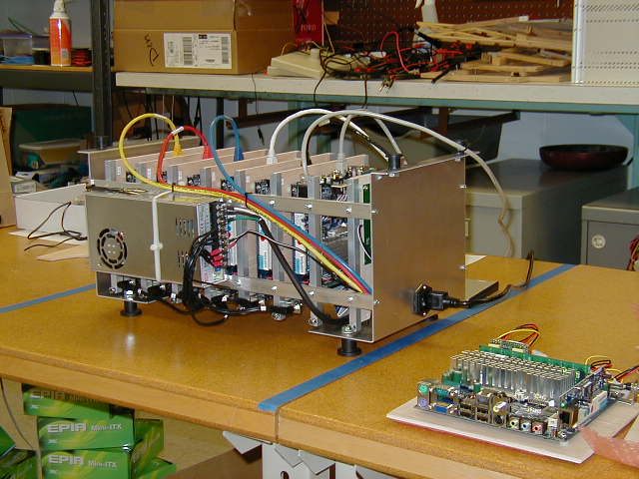
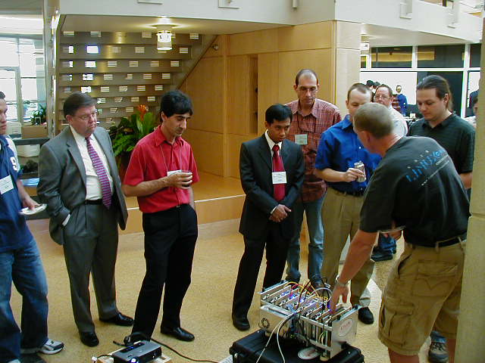
LittleFe
LittleFe is a little cluster in a box, specifically DESIGNED FOR TEACHING:
Costs $2500
Perfectly portable, even on a plane
Runs Bootable Cluster CD (BCCD) software stack (designed for teaching)
littlefe.net, bccd.net
“attractive nuisance”
Students can’t stop playing with it!

Slide 38
LittleFe @ Summer Workshops & SC11
Intel has committed co-funding for hardware and related costs: $75,000
Build ~10 LittleFe units at Intermediate Parallel Programming & Cluster Computing summer workshop (U Oklahoma & Polytechnic U Puerto Rico)
Build 10-15 LittleFe units at the SC11 Education Program, in the Communities Booth (across from the conference registration booth)
Selection committee chooses institutions to award LittleFe units to, based on:
Faculty already know some HPC and want to teach it
Letter of commitment for curriculum changes
Periodic checks that each unit is being used well

Slide 39
LittleFe Applications
Evaluating now
45 applications for 25 units
public, private, for-profit
PhD-granting, masters-granting, primarily undergraduate, community colleges
minority serving institutions
21 US states & territories (includes 7 EPSCoR)
AR, CA, FL, GA, LA, MA, MD, MI, MN, NC, NJ, NY, OK, PA, PR, SC, SD, TX, VA, WA, WV
several female and underrepresented minority faculty

Slide 40
Cyberinfrastructure and Students

Slide 41
Moore’s Law
In 1965, Gordon Moore was an engineer at Fairchild Semiconductor.
He noticed that the number of transistors that could be squeezed onto a chip was doubling about every 18 months.
It turns out that computer speed is roughly proportional to the number of transistors per unit area.
Moore wrote a paper about this concept, which became known as “Moore’s Law.”

Slide 42
Moore’s Law Observed
GFLOPs:
billions of calculations per second
42

Slide 43
CI and Young Californians
Historically we’ve seen that whatever happens at the high end of computing today will be on your desktop in 10 to 15 years.
So, for California undergrads to learn about high end Cyberinfrastructure puts them ahead of the curve:
they’ll be more competitive now;
they’ll know something important about the future.

Slide 44
The Future is Now
Computing power doubles every 18 months.
Undergrads are about 20 years old.
Life expectancy in the US is about 80 years.
So they have about 60 years left.
How much more powerful will computers be in 60 years?
15 years = 10 doublings = 1024x ~ approx 1000 times better
30 years = 20 doublings ~ approx a million times better
45 years = 30 doublings ~ approx a billion times better
60 years = 40 doublings ~ approx a trillion times better
The problem with the future: “The future always comes too fast, and in the wrong order.” (Alvin Toffler)

Slide 45
Thanks for your attention!
Questions?
www.oscer.ou.edu
hneeman@ou.edu

